Slide 1
MediSync Solutions
EMR Scheduling System
Nafisa Emmanuel, Maha Siddiqui, Ali Akcin, Isha Patel

Slide 2
MediSync Solutions
EMR Scheduling System
Objective is to simplify and enhance efficiency in appointment booking in healthcare
Streamlines scheduling process (eliminating phone calls and wait times)
Patients have easy access to the available appointment schedule and their medical history
Empower patients and medical professionals through technology to make healthcare more accessible, convenient, and efficient
Notes:
At MediSync Solutions, our goal is to simplify and enhance the healthcare appointment process. We created an Electronic Medical Records Scheduling system that streamlines the scheduling process and allows patients to have easy access to their medical information.
Temah Healthcare was frustrated with the current scheduling system. We understand the frustrations and inefficiencies that patients and medical specialists encounter daily.
Many people book their appointments during their last appointment or over the phone. This can leave patients frustrated as exchanging available times between the patient and receptionist can be hard. Long wait times also make this process less efficient.
Our scheduling system lets patients view all the available appointments slots and book them whenever and wherever they want to.
With this we are empowering patients and medical specialists through technology to make healthcare more accessible, convenient, and efficient.

Slide 3
Functional Requirements (Providers)
Insert Appointment Slot:
Process-oriented
2.1 Enable medical specialists to insert their available appointment time slots.
2.2 Specify available time slots, dates, and specialization of the medical specialist for each available slot
Modify Appointment Slot:
Process-oriented
3.1 Provide functionality for medical specialists to modify existing appointment time slots.
3.2 If the appointment has been taken, the patient will receive a notification for rescheduling.
Delete Appointment Slot:
Process-oriented
4.1 Enable medical specialists to delete their appointment time slots.
4.2 Notify patients if appointments are canceled, providing reasons and options for rescheduling.
Appointment Reminders:
Information-oriented
5.1 Send appointment reminders to medical specialists 48 hours before scheduled appointments.
5.2 Include relevant details such as time, date, and patient information.
Insert Appointment Summary:
Process-oriented & Information-oriented
6.1 Allow medical specialists to provide appointment summaries after scheduled appointments.
6.2 Ensure visibility to both medical providers and patients for medical history reference
Appointment Prioritization:
Process-oriented
7.1 The EMR system applies an automated prioritization algorithm to evaluate the urgency of the patient.
7.2 The EMR system generates priority assessments for patients with the most critical condition.

Slide 4
Functional Requirements (Patients)
Create Patient Profile:
Process-oriented
7.1 Allow patients to register and create their accounts.
7.2 Capture essential details such as name, contact information, and medical history during profile creation.
Schedule Appointments:
Process-oriented
8.1 Enable patients to schedule appointments with medical specialists.
8.2 Provide options to filter open appointment slots based on the department or specialization needed.
Appointment Cancelation:
Process-oriented
9.1 Allow patients to cancel their appointments as needed.
9.2 Notify medical specialists about the cancellation and the reasons for it.
9.3 Provide patients with options for rescheduling.
Appointment Reminders:
Information-oriented
10.1 Send appointment reminders to patients 48 hours before scheduled appointments.
10.2 Include relevant details such as time, date, and medical specialist information in the reminder.
Access to Medical History:
Information-oriented
11.1 Allow patients to access appointment summaries provided by medical specialists after scheduled appointments.
11. 2 Allow patients to overview their past appointments, and medical history.
Virtual Waiting System:
Process-oriented & information-oriented:
12.1 Implement a virtual waiting system for patients to check-in remotely before their scheduled appointments.
12.2 Display real-time queue status, indicating the estimated wait time and their position in the queue.
12.3 Provide patients with health-related news, tips, and updates while they wait.

Slide 5
Acquisition Strategy
Hybrid Approach Overview:
Custom Development: Building critical components such as patient account creation, appointment scheduling, and reminder functionalities in-house.
Outsourcing: Leveraging external expertise for non-core functionalities like the virtual waiting system, ensuring efficiency and cost-effectiveness.
Reasons for Choosing Hybrid Approach:
Flexibility: By blending custom development and outsourcing, we attain flexibility to tailor patient-centric features while efficiently managing non-core tasks.
Risk Mitigation: Diversifying resources through a hybrid model mitigates risks associated with development challenges, ensuring continuity in service delivery.
Cost Efficiency: Outsourcing non-core functionalities helps control costs, optimizing resource allocation while maintaining focus on critical aspects of the project.
Adaptability: The hybrid approach allows us to adapt to evolving requirements or circumstances, ensuring our system remains agile and responsive to user needs.
Compliance and Security: Custom development enables us to implement robust security measures tailored to healthcare standards, ensuring data privacy and regulatory compliance.
In summary, the hybrid acquisition strategy combines the benefits of custom development and outsourcing, providing the flexibility, risk mitigation, cost efficiency, adaptability, and security necessary for the success of our healthcare project.

Slide 6
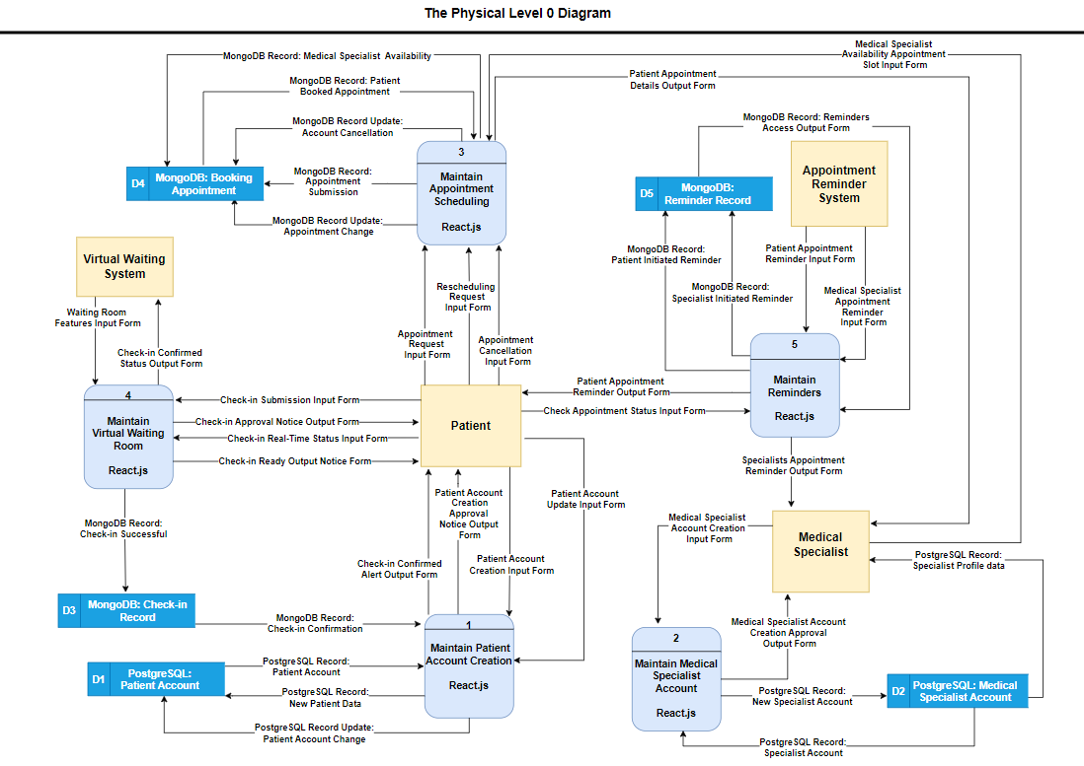

Slide 7
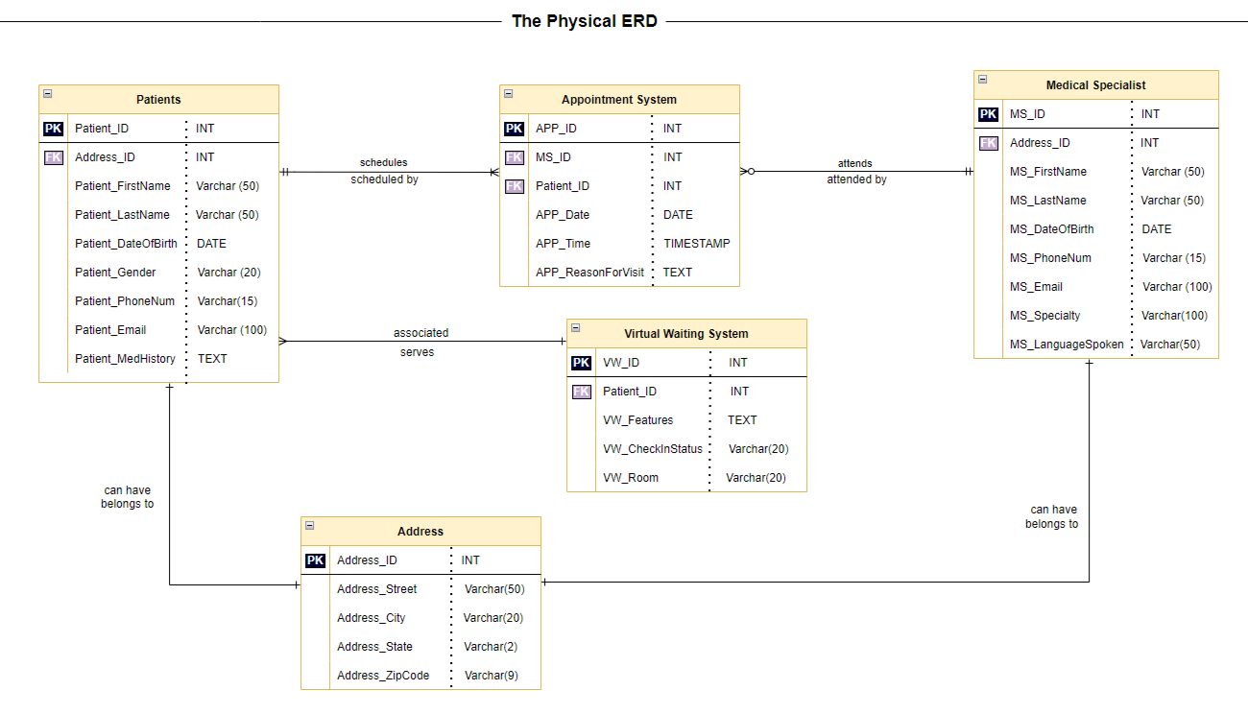




Slide 8
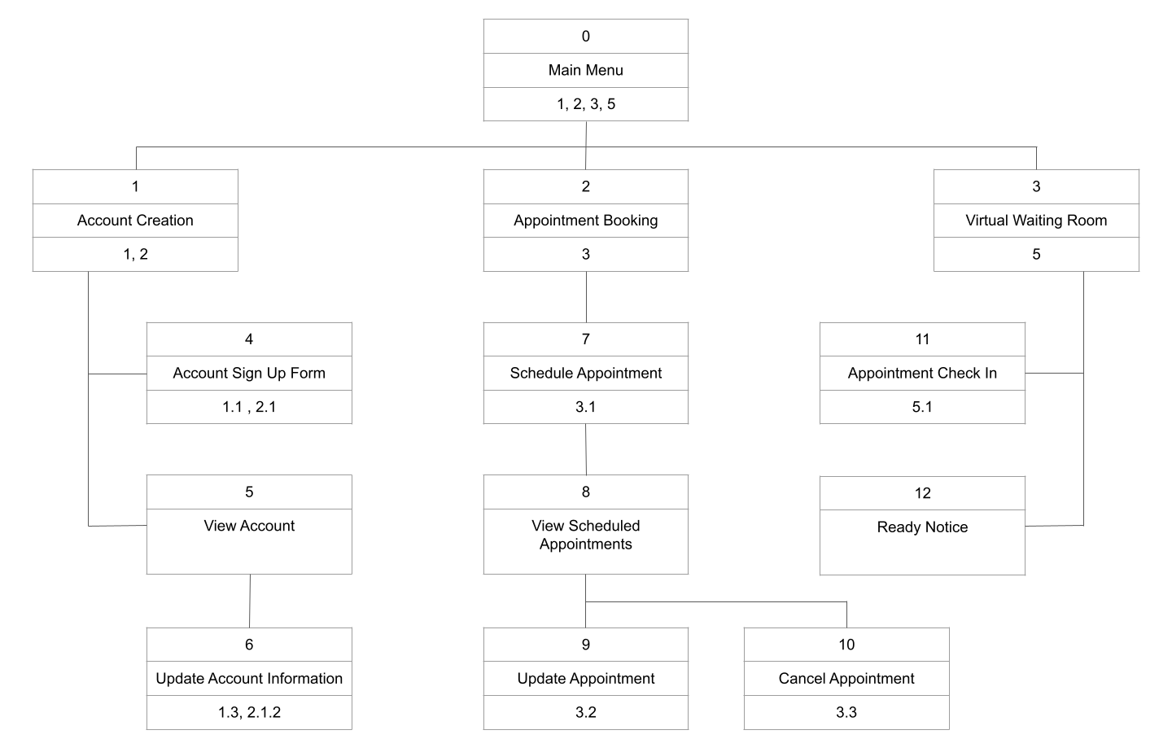
Interface Structure Design

Slide 9
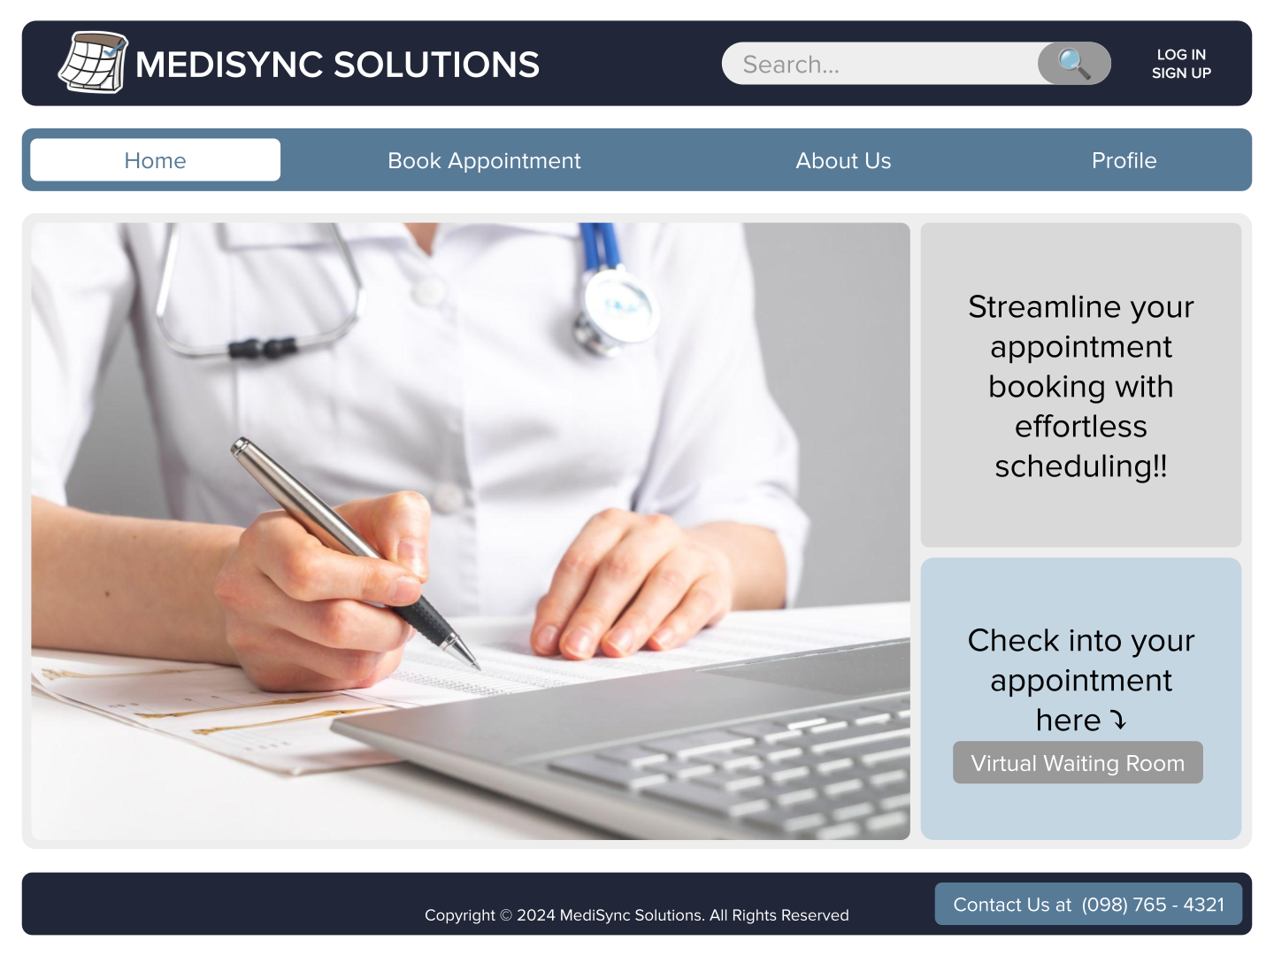

Slide 10
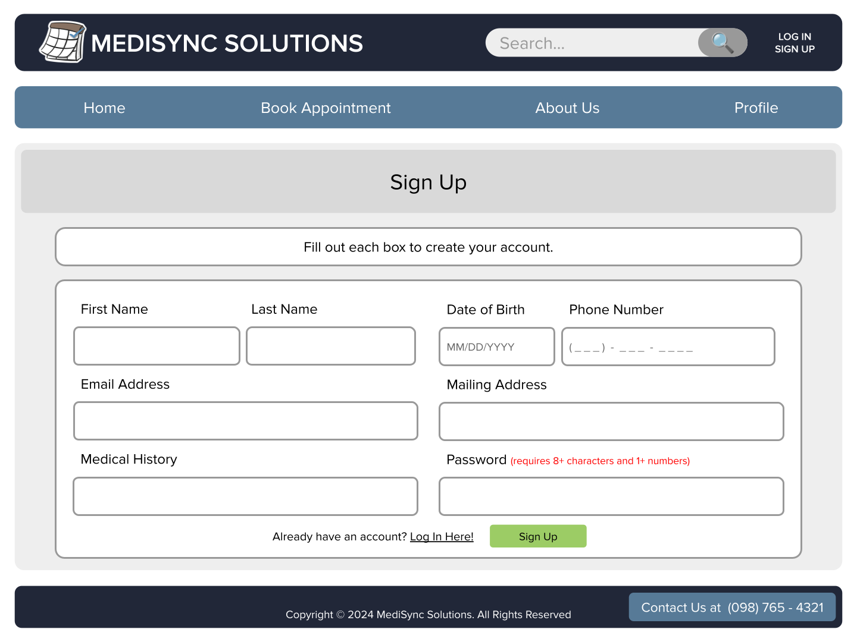

Slide 11
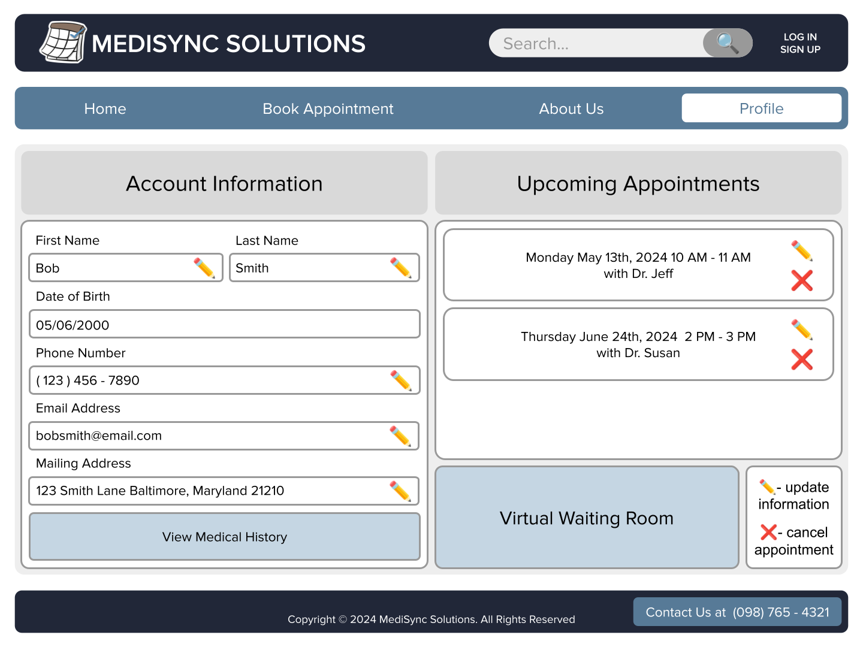

Slide 12
Project Reflection
Problems
Large project scope. focused only on scheduling
Time Management
Documentation
Learned
Effective communication and collaboration.
Creating a scheduling EMR system exposed us to real-world challenges in healthcare.
SDLC taught us the importance of meticulous planning and continuous feedback loops.
Notes:
Throughout the project, our team encountered several challenges that tested our problem-solving skills and taught us valuable lessons about the System Development Life Cycle.
One major challenge we faced was our project scope. Initially, we had a very large scope. We wanted to push everything into our system but that wasn’t practical for our expertise and the amount of time we had. We decided to focus only on scheduling and were able to conduct extensive interviews, a questionnaire, and more research to make sure we are in agreement between the user needs and our solution.
Balancing project deadlines with other academic or personal commitments was a bit challenging. But we fixed this by prioritizing tasks effectively and manage our time efficiently setting reminders
Through our challenges, we gained valuable insights about how effective communication and collaboration among our team and project sponsors are crucial for project success.
, emphasizing privacy, security, and regulatory compliance. It provided practical insights into system analysis concepts in this critical industry.
In conclusion, our journey through the SDLC taught us the importance of meticulous planning and continuous feedback loops. By using these principles, we were able to navigate challenges effectively and deliver a simplified and efficient scheduling system to our users.

Slide 13
Thank you for your time!

